Slide 1
Interactive Sales Dashboard In Tableau
Name: Varsha Sharma
Project Title: Dashboard Design
Date: 13.04.2025

Slide 2

Tools Used:
Tableau
Excel (for data preparation)
Adidas Sales Dataset
PowerPoint for presentation
Objectives
To design an interactive sales dashboard using Tableau.
2. Analyze Adidas Sales by region, category and time
3. Highlights KPIs such as Sales, Profit, and Growth
4. Deliver data-driven insights for strategic decisions.
Through Data We Run Further
A sales dashboard analysis for Adidas.

Slide 3
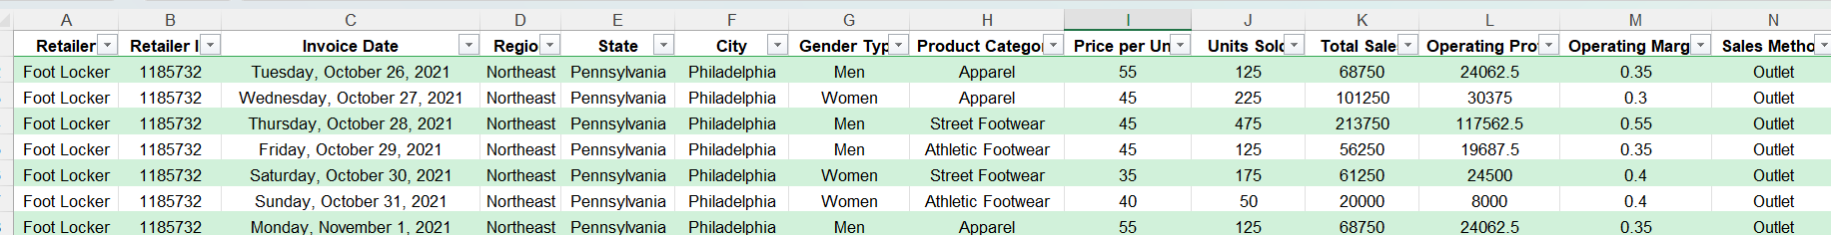
Dataset Overview:
Key Columns:
Order Date
Region
Category
Sales
Profit
Discount
Quantity
Shipping Cost
Customer ID
Product Name
“The dataset includes sales-related fields like Order date, Region, Category, and Financial metrics such as sales, profit , and discount.”

Slide 4
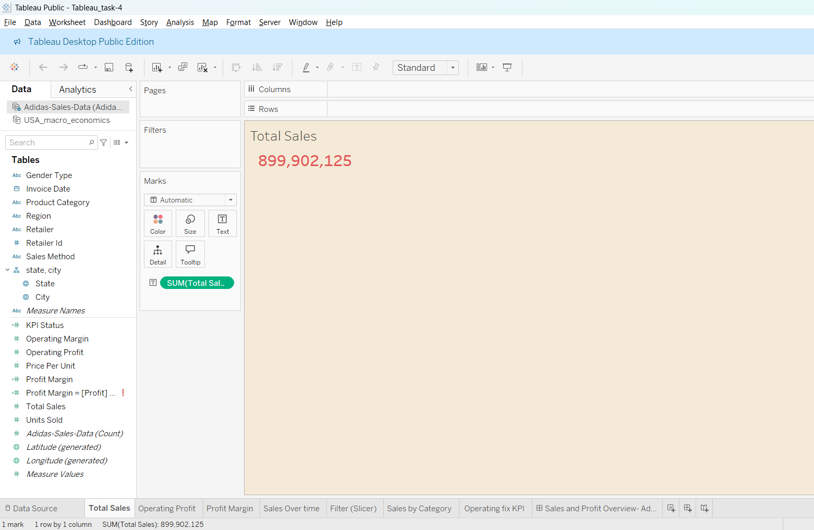
Total Sales
This KPI card displays the total revenue generated across all regions and product categories. It gives a high-level view of business performance.

Slide 5
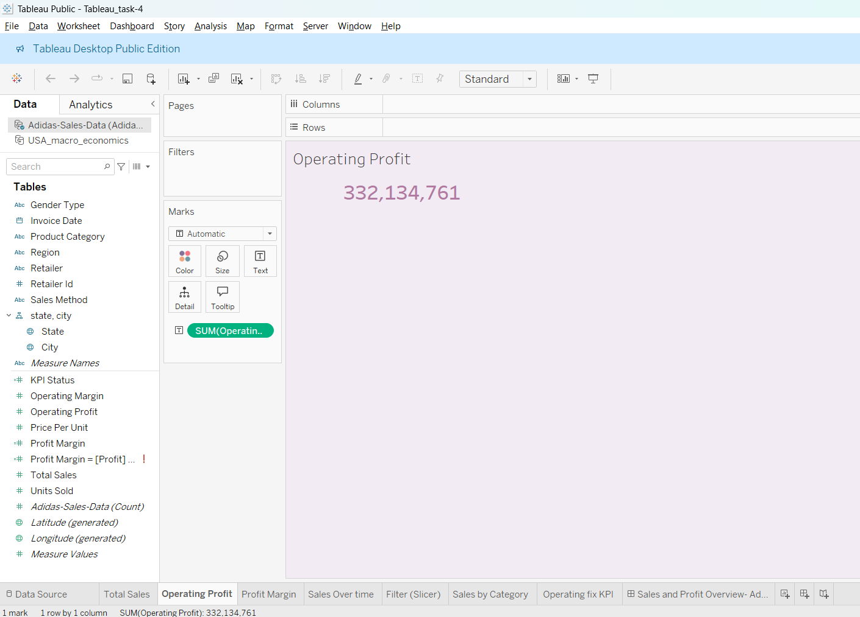
Operating Profit
Operating profit shows how much income remains after accounting for the cost of goods sold and other operating expenses. It reflects business efficiency.

Slide 6
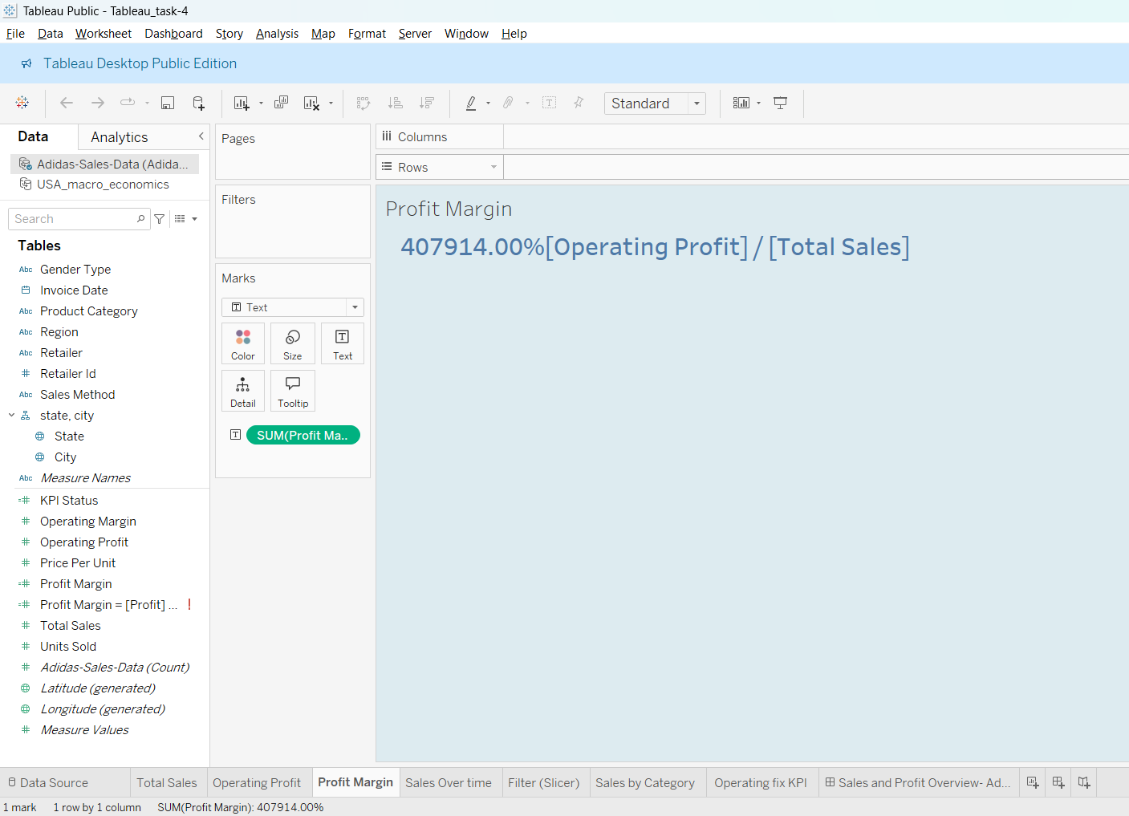
Profit Margin
.
Profit Margin represents profitability as a percentage of sales. It helps access how well the company converts revenue into actual profits.

Slide 7
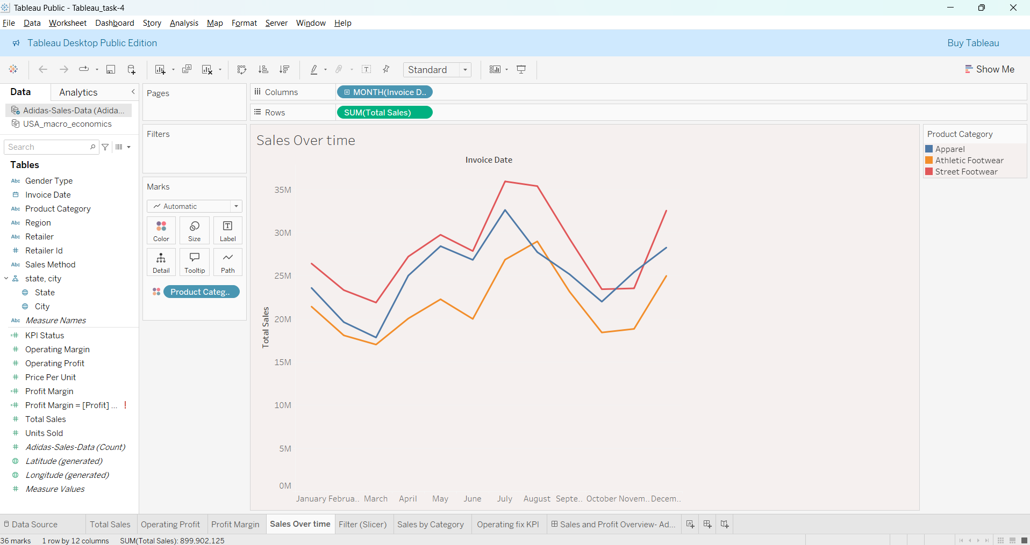
Sales Over Time (Line chart)
This time series chart illustrates monthly or quarterly sales trends. It also helps identify seasonal patterns and peak performance period.

Slide 8
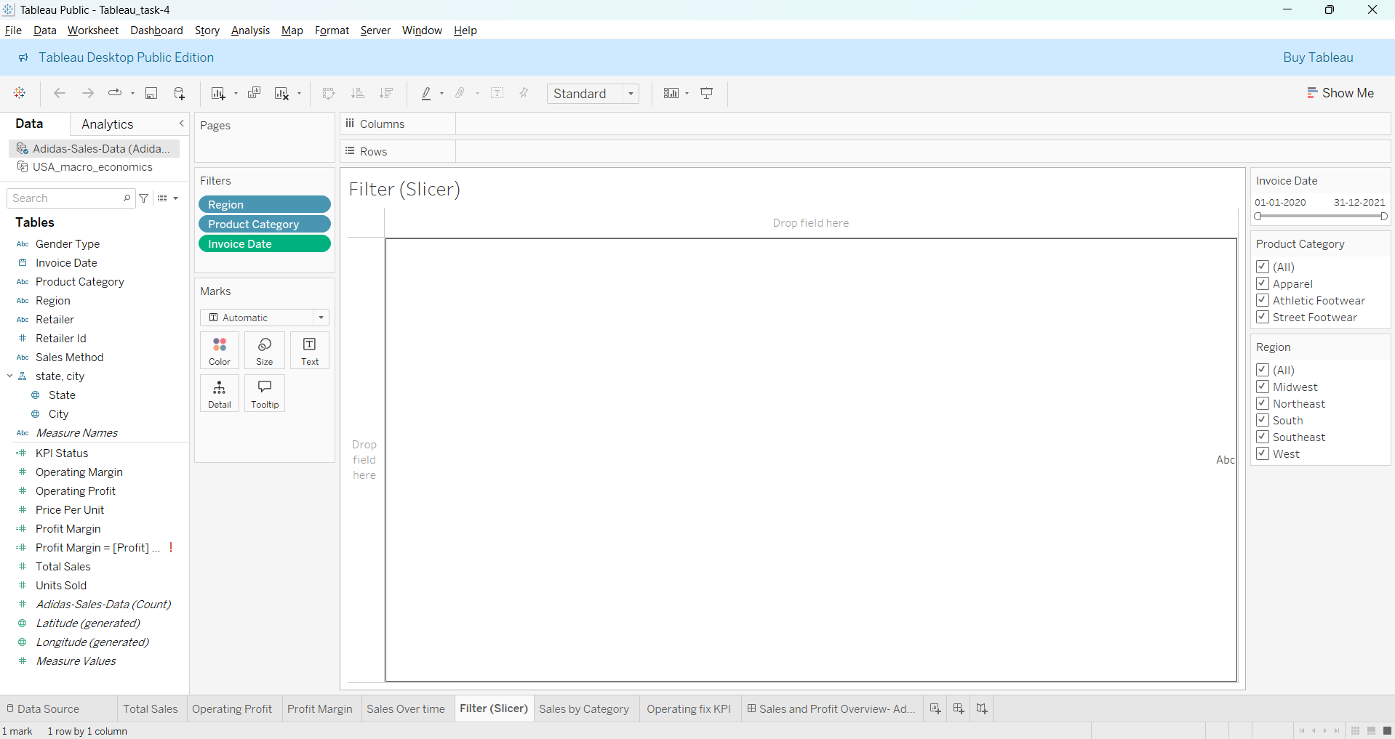
Filter(Slicer) (Category, region and date)
Filters allow the users to explore the dashboard interactively by selecting specific regions, products category and time periods.

Slide 9
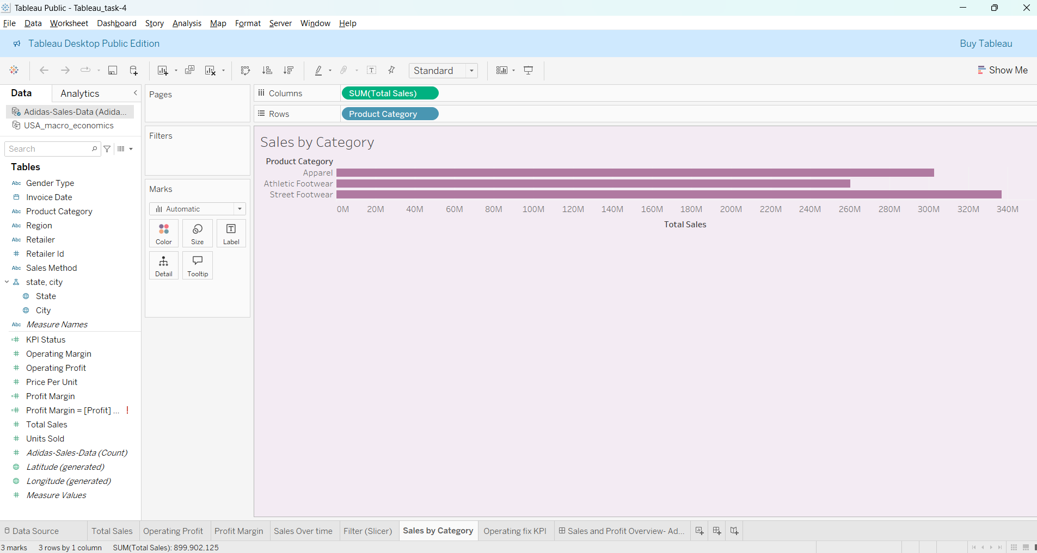
Sales by Category (Bar or pie chart)
This chart breaks down sales across various product categories. It helps understand which categories contribute the most to total revenue.

Slide 10
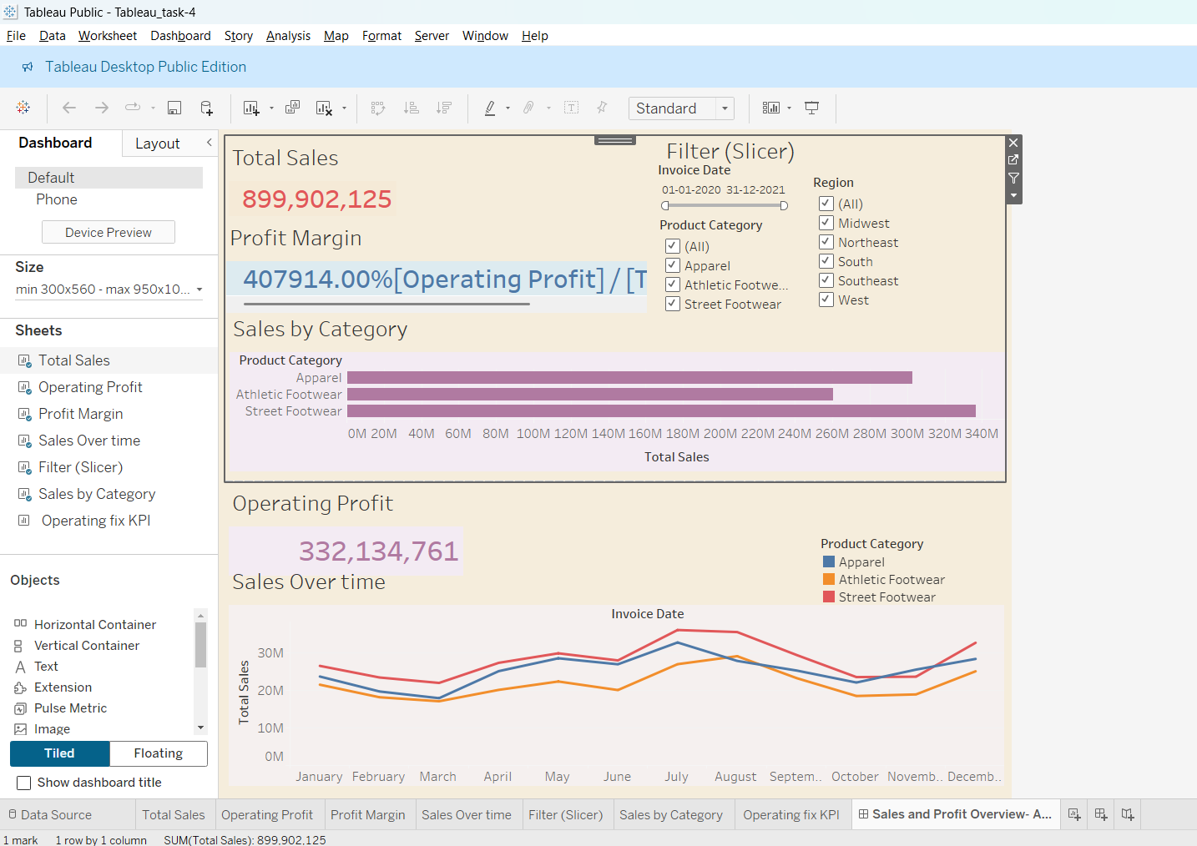
Final Dashboard
The final dashboard presents an interactive, visually appealing summary of sales data. It highlights key KPIs, category performance and trends, empowering business stakeholders to make informed decisions.

